Slide 1



E-TEXTILES
Seminar presentation
BY : DEVANSH VERMA
GUIDE : DR. BINDU GARG

Slide 2


Outline
Introduction to Wearable Technology and E-Textiles
Applications of E-Textiles
Advantages of E-Textiles
Challenges and Limitations of E-Textiles
Future of E-Textiles
Conclusion

Slide 3


Introduction
Wearable technology is a type of electronic device that can be worn on the body.
E-Textiles are fabrics that have electronic components embedded in them.
The first wearable technology was invented in the 1960s.
E-textiles are still in the early stages of development.

Slide 4

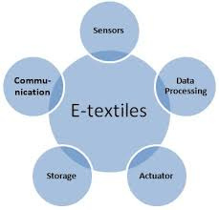
Properties of E-Textiles
Comfort
Portability
E-textiles can be made from soft, flexible materials that are comfortable to wear.
E-textiles can be easily transported and worn anywhere.
Flexibility
Durability
E-textiles can be designed to fit a wide range of body types and shapes.
E-textiles can be made to withstand wear and tear.

Slide 5


Advantages of E-Textiles
Integration of Electronics
Improved Functionality
Personalize and Aesthetics
Environmental Sustainability
Comfort and Flexibility

Slide 6
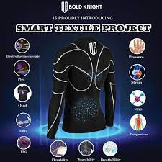
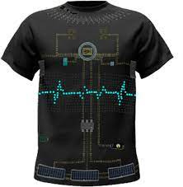

Applications of E-Textiles
Healthcare
Sports and fitness
Military and defense
Fashion and entertainment
Notes:
Healthcare - E-textiles can be used to monitor patients' vital signs.
Sports and fitness - E-textiles can help athletes track their performance and monitor their health.
Military and defense - E-textiles can be used for camouflage and to detect enemy movements.
Fashion and entertainment - E-textiles can be used to create interactive clothing and costumes.

Slide 7
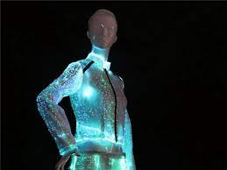
Challenges and Limitations of E-Textiles
Integration with other technologies - E-textiles need to be compatible with other devices and systems.
Energy consumption - E-textiles require power to function, which can be a challenge to sustain.
Maintenance and repair - E-textiles may require special care and maintenance.
Cost - E-textiles can be expensive to produce and purchase.

Slide 8
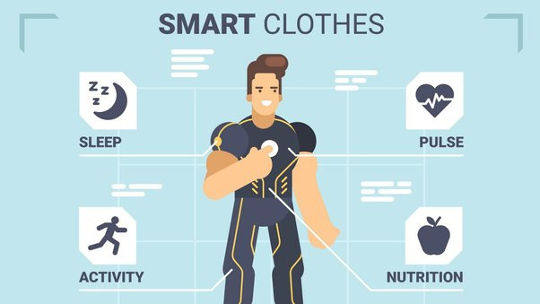
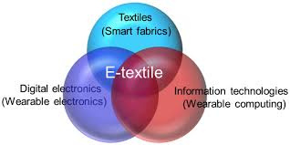
Future of E-Textiles
Emerging technologies - New technologies such as nanotechnology and smart fabrics are being developed for e-textiles.
Market trends - The e-textile market is expected to grow rapidly in the coming years.
Potential innovations - E-textiles have the potential to revolutionize healthcare, sports, and fashion.
Impact on society and the environment - E-textiles may have both positive and negative effects on society and the environment.

Slide 9




Conclusion
Implications for industry and consumers - E-textiles have the potential to transform many industries and improve consumers' lives.
Call to action - More research and development are needed to fully realize the potential of e-textiles.
Final thoughts - E-textiles are an exciting and rapidly developing field with many possibilities for innovation and growth.

Slide 10

THANK YOU

